Slide 1

E-Commerce
SHUBHAM JAISWAL
27 FEB 2024

Slide 2

INTRODUCTION
Amazon is an American multinational technology company focusing on e-commerce, cloud computing, online advertising, digital streaming, and artificial intelligence.
Amazon was founded on July 5, 1994, by Jeff Bezos from his garage in Bellevue, Washington.The company initially was an online marketplace for books, but incrementally expanded into a multitude of product categories.

Slide 3


As a business analyst at amazon our work is to maintain the company performance and seek improvement.
We have to keep working in improving the performance by seeking new strategies which will benefit both the customers and company too.
Here we will see the performance over the year and will try to implement new rules to increase the sales and will also introduce a prime membership for our loyal and regular customers.

Slide 4

products available
if we go through the data provided by the company we will observe that a total of 107232786 sale value is generated by the 44 unique products available in the company.
These 44 products are divided in 5 categories in which there are 16 sub-categories.

Slide 5
Revenue generated by products available on Amazon

Slide 6
Revenue generated by different product category

Slide 7
Revenue generated by different product Sub-category

Slide 8
Customers over the years looking the graph we can find the customers who ordered products over the year 2015 - 17624 2016 - 17631 2017 - 17669 2018 - 17352 2019 - 17535 2020 – 25179 If we look at data from 2015 to 2019 the number of customers is approximately same but in 2020 it increased by 40%.

Slide 9
Product performance

Slide 10
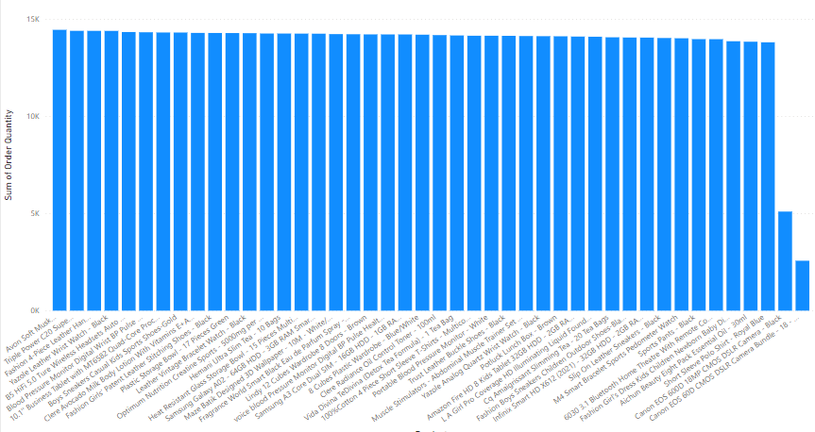
popularity of products

Slide 11
popularity of products
The products in demand are to be kept in stock every time,
Among the products the top 5 best selling products are-
Avon Soft Musk Eau de Toilette Spray - 50ml (14444 units)
Triple Power C20 Super Bass USB Bluetooth Subwoofer - Brown + free S530 V4.0 Bluetooth Headset – Black (14392 units)
Fashion 4-Piece Leather HandBag Set – Black (14391 units)
Yazole Leather Wrist Watch – Black (14389 units)
B5 HiFi 5.0 Ture Wireless Headsets Auto Pair Touch – Black (14331 units)

Slide 12
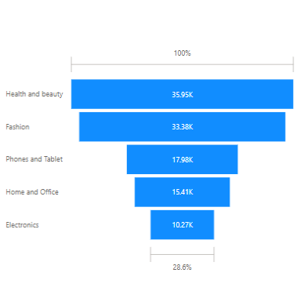
popular product category

Slide 13
popular product category
The popular product category could be known by the order received in that category.
By the graph, the number of orders received in different product categories are-
Health and beauty (35951 order)
Fashion (33383 order)
Phones and Tablet (17977 order)
Home and office (15408 order)
Electronics (10271 order)

Slide 14
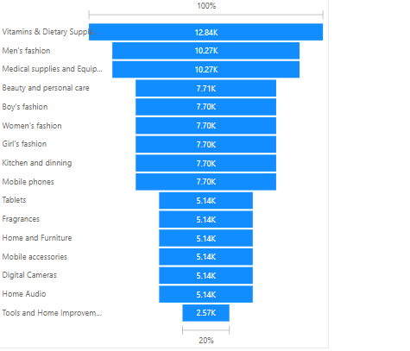
popular product sub-category

Slide 15
popular product sub-category
In the same way as the above –
Top 5 best selling sub-categories are-
Vitamins & Dietary Supplements (12838 order)
Men's fashion (10272 order)
Medical supplies and Equipment (7707 order)
Beauty and personal care (7704 order)
Boy's fashion (7704 order)

Slide 16
Product performance over the year

Slide 17
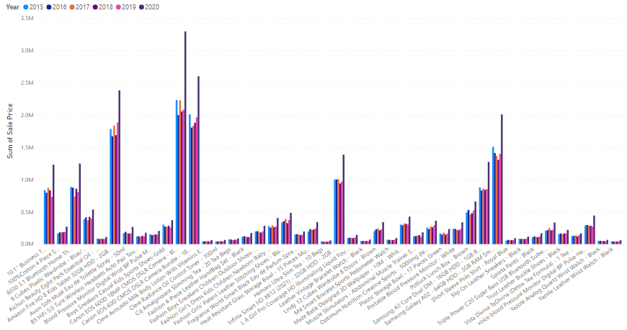
Product performance over the year

Slide 18
Product performance over the year
If we go through the product sale in each year we will find the below outcomes –
Most of the products have seen an increase in the sales over the years.
Top 3 top performing products are-
Canon EOS 600D 18MP CMOS DSLR Camera – Black
Canon EOS 60D CMOS DSLR Camera Bundle - 18 - 55mm Lens - Black
Amazon Fire HD 8 Kids Tablet 32GB HDD - 2GB RAM - 8" Blue

Slide 19
Revenue generated by products in different year

Slide 20
From the above data we can identify the low performing products
To increase the sales of low selling we can do the following things-
Give some discounts on those products
Ensure safe and secure delivery
Understanding customer need
Be more realistic on product description

Slide 21
Delivery

Slide 22
Delivery status
The delivery status plays a crucial role in profit, as a successful delivery will cut extra cost of collecting the damaged product and delivering it again.
From the graph, the outcome is-
After the product is delivered , 82467 among them is successful and 30523 orders were returned.

Slide 23
Reason for returning order
The reasons for returning the product by the customers were as follows -
If we see chart, the most of the reason to return the product is delivery of defected items which would be because of improper handling of the product at the delivery end, which needs to be overcome.
The second reason is description mismatch which could be overcome by being more realistic at the describing the product.

Slide 24
Sale according to product ratings
Ratings of the product don’t impact the sales value as we can see through the above chart that high rated products have low sale value as compared to low rating products.

Slide 25
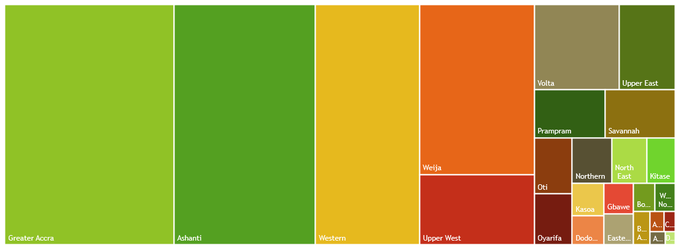
Sales according to location

Slide 26
Sales according to location
Top 5 high revenue locations are-
Greater Accra (27 million sale value)
Ashanti (23 million sale value)
Western (17 million sale value)
Weija (13 million sale value)
Upper West (5 million sale value)
Company should focus on the above mention location more as they are companies best consumer areas.

Slide 27
Sales according to different month
When the sale of product in different month of each year was graphed, we found that -
June and September months are low performing.
To boost the sale in these month we can have some sale or additional discounts on cart value to boost the sales.

Slide 28
Underperforming products according to unit price

Slide 29
Underperforming products according to unit price
Items which have high price but low performance are-
Product of unit price 4700 – 2567 units sold
Product of unit price 2720 – 5096 units sold

Slide 30
Products whose sales needs to be boosted
These two items are least sold products which needs to have discounts to increase their sale -
Canon EOS 60D CMOS DSLR Camera Bundle - 18 - 55mm Lens - Black
Canon EOS 600D 18MP CMOS DSLR Camera – Black

Slide 31
Loyalty program
The customers who order products with high cart value can be given some discounts to motivate them in buying more.
Customers having multiple orders can be given concession on shipping charges.
Products which have high unit price can be shipped freely.
Those standard deliveries which take less time can have reduced shipping charges.

Slide 32
Effect of product category on delivery time
If we see the data the time taken for delivery is almost same for all the product category.

Slide 33
Effect of delivery type on delivery time
Time taken by the shipment from abroad is taking much time and the express delivery is taking least time.

Slide 34
Relation between shipping charge and product type

Slide 35
Steps to increase rating of low rated product
Following steps could be taken to increase the ratings of low rated products-
The rates of the low rated product can be decreased
Their delivery should be more fast
It should be delivered through express deliveries.

Slide 36
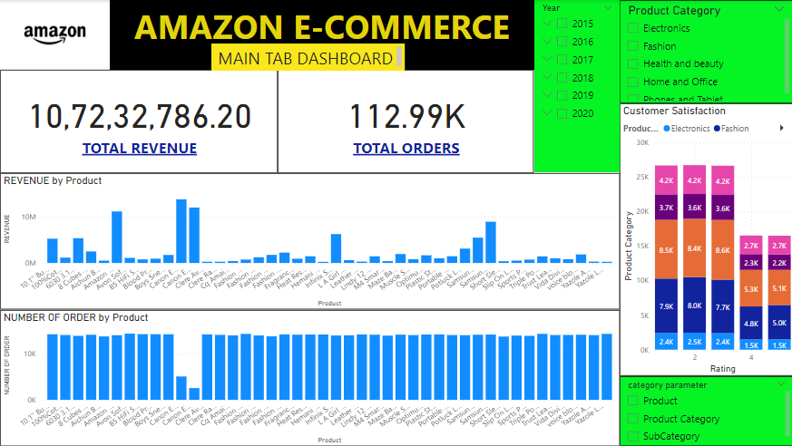

Slide 37
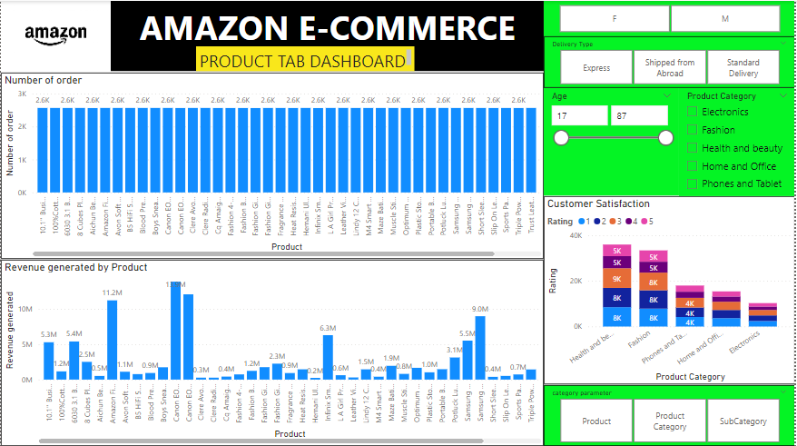

Slide 38
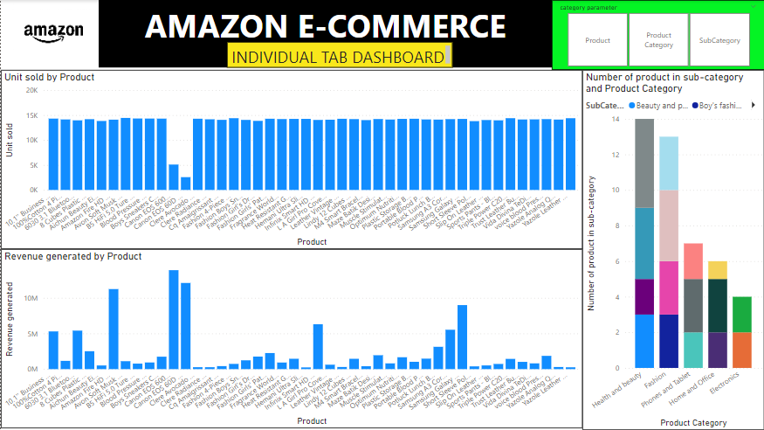

Slide 39
CONCLUSION
Our presentation has highlighted the key elements that define Amazon's success: its customer-centric approach, commitment to technological advancement, expansive logistics network, and diversified service offerings. Moreover, we have explored the company's impact on various industries, its sustainability efforts, and its future outlook.

